Slide 1
THE HABITAT
OPS Team 5

Slide 2
Contents
1
1
About Project
2
Demo Video
3
Opensource
4
Our Team
5
Live Demo

Slide 3
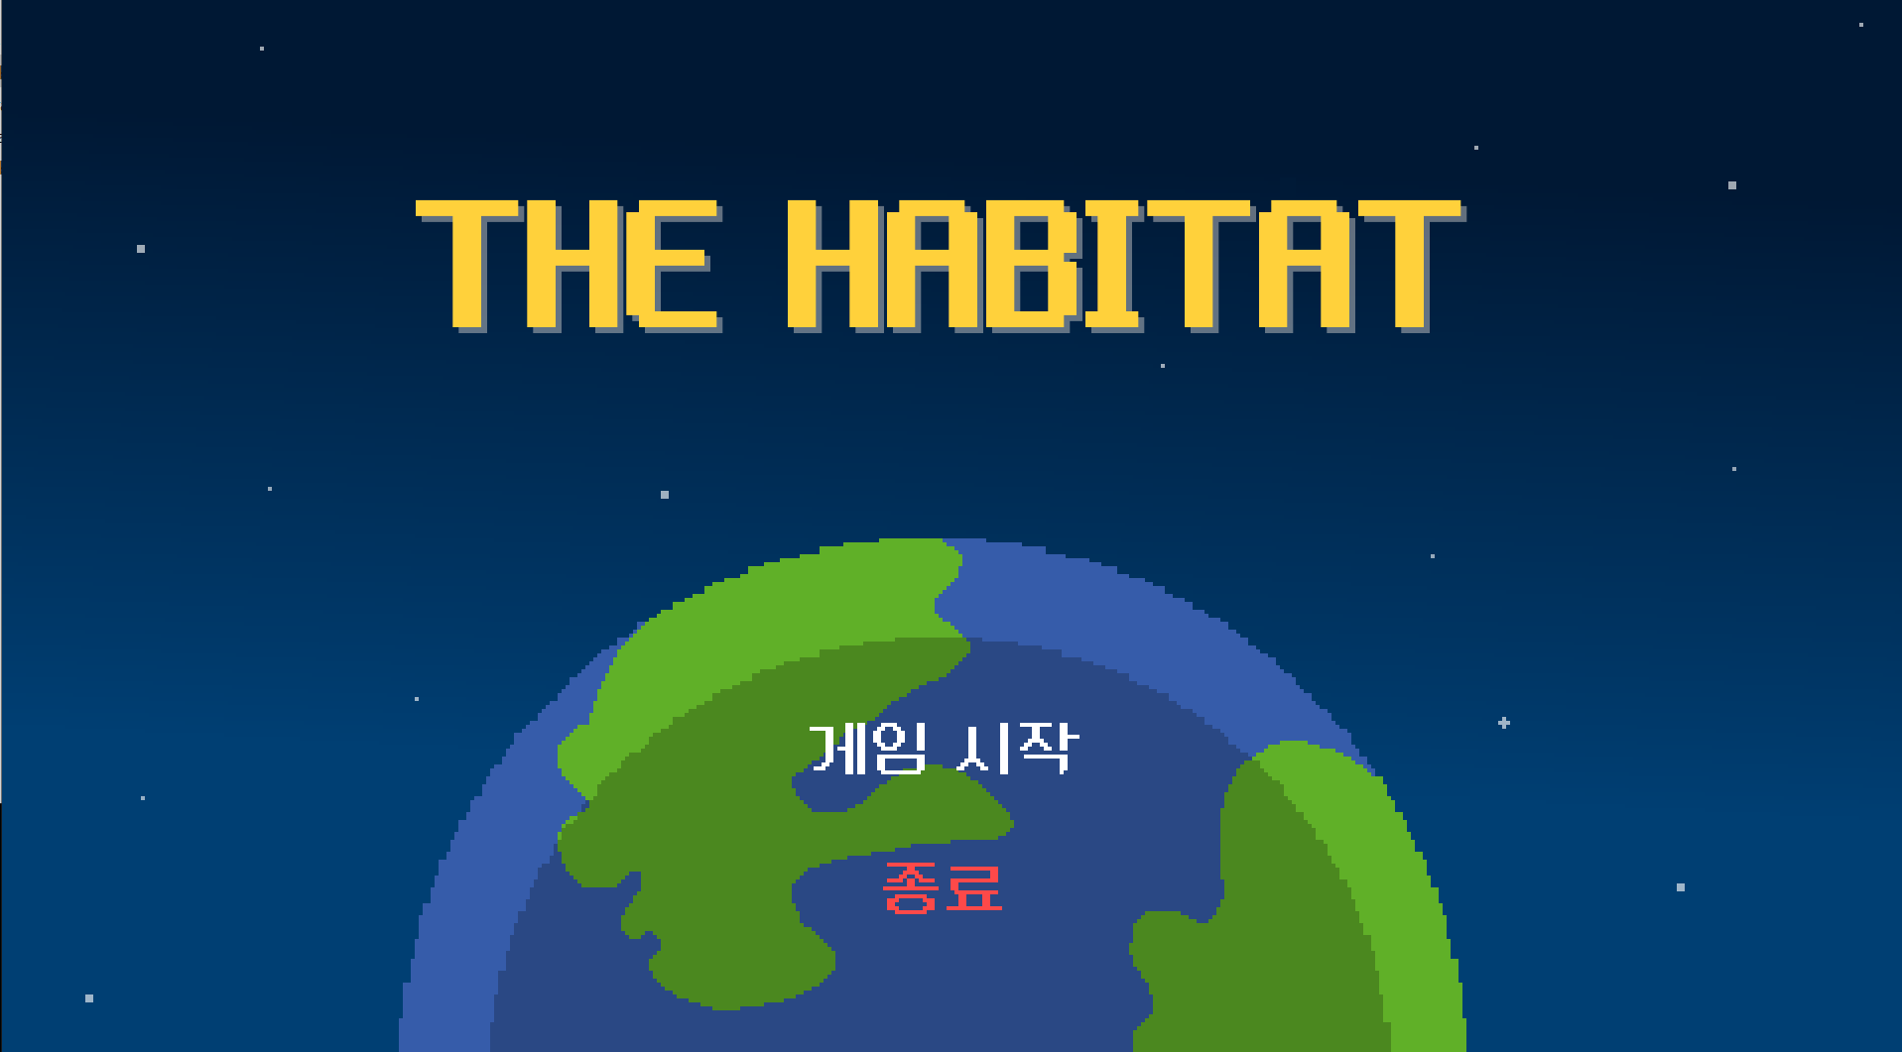
About Project

Slide 4
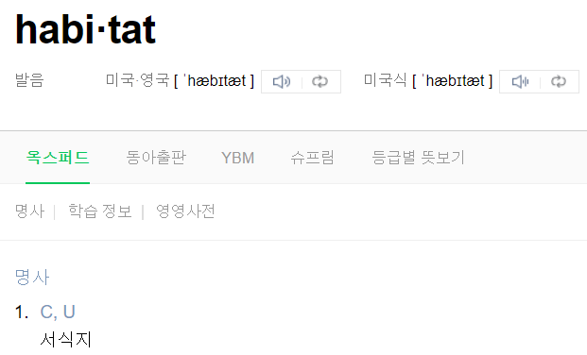
About Project
THE HABITAT

Slide 5
About Project
nature
people
animal

Slide 6
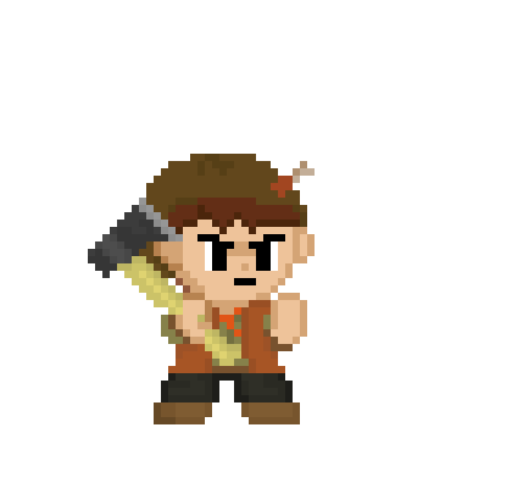
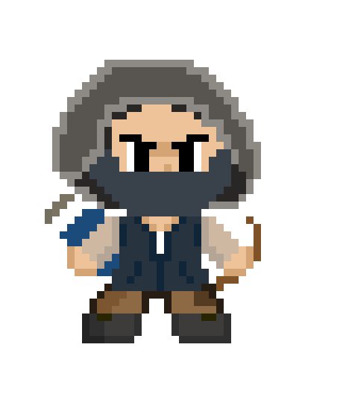
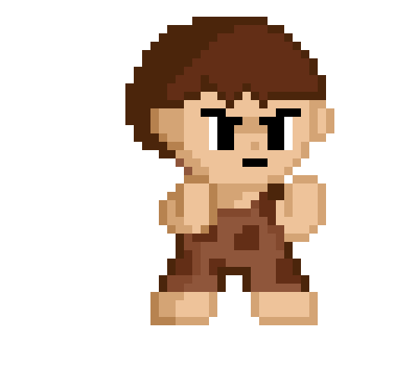
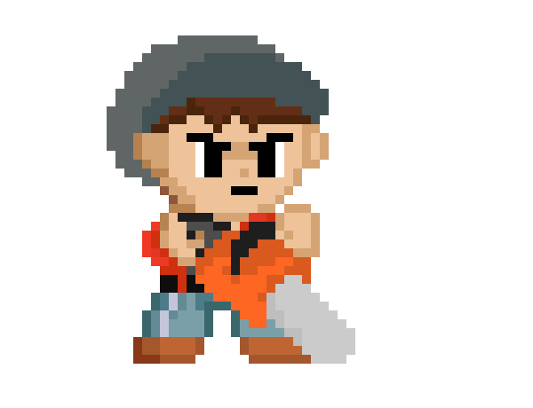
About Project
modernization
Stage 01
Stage 02
Stage 03
Stage 04

Slide 7
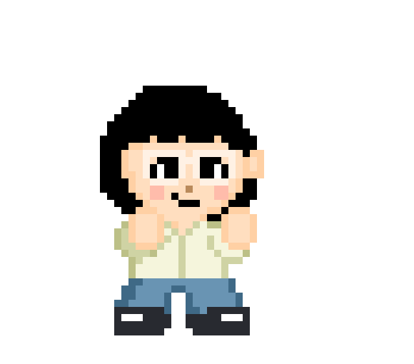
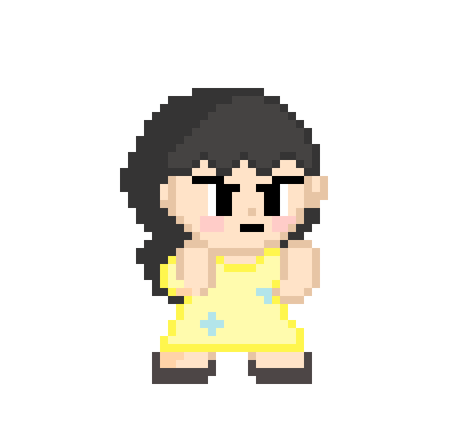
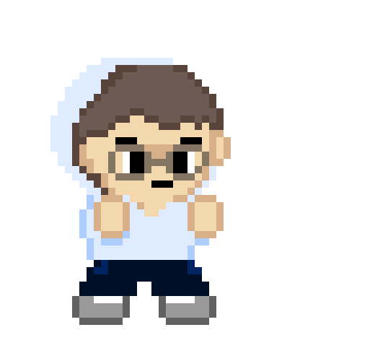
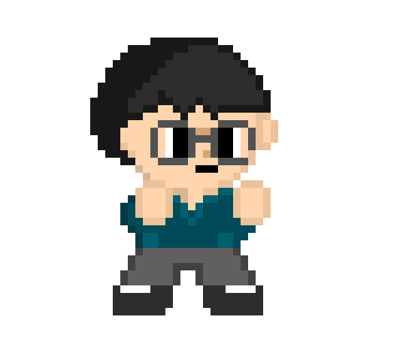
About Project
Boss stage

Slide 8
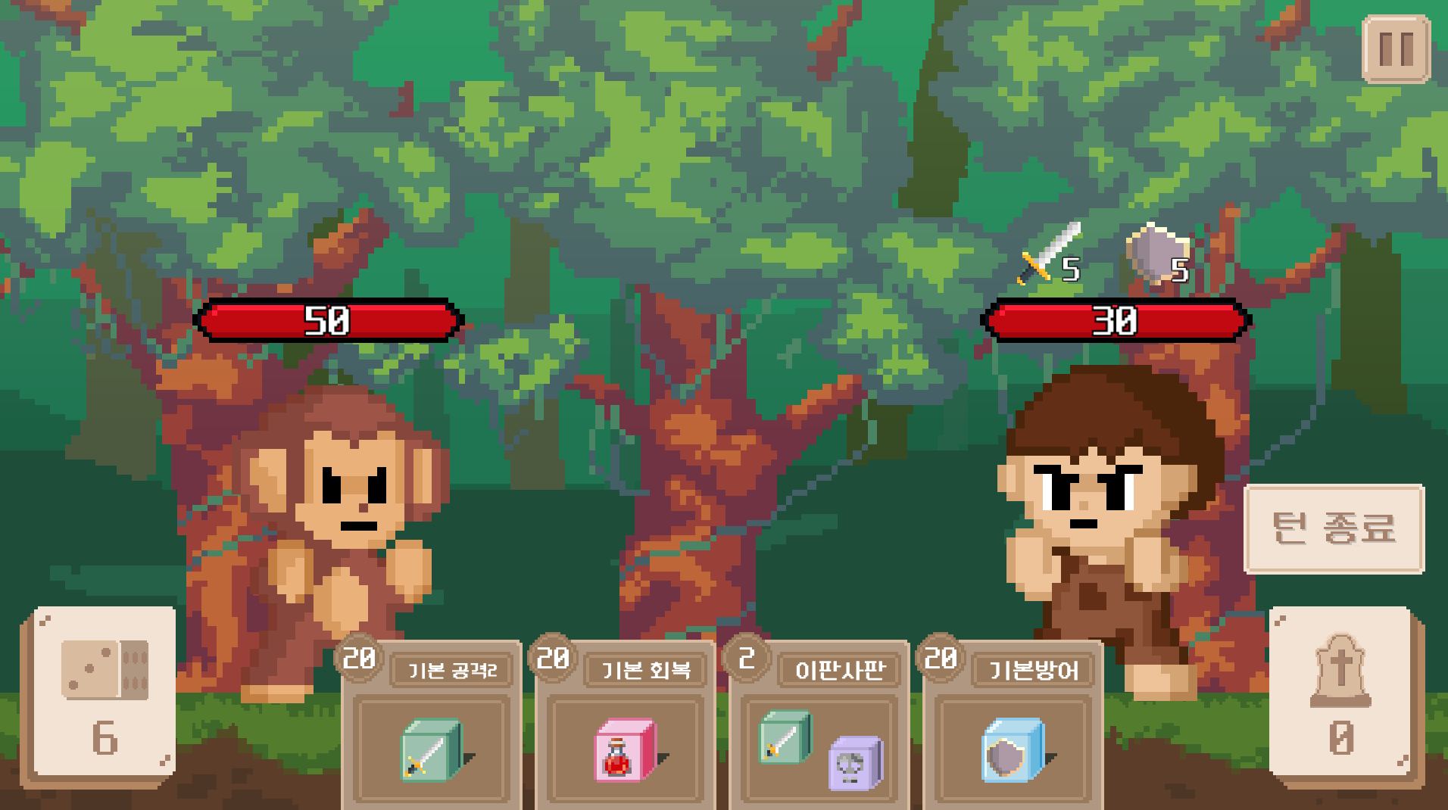
About Project
Play rule

Slide 9
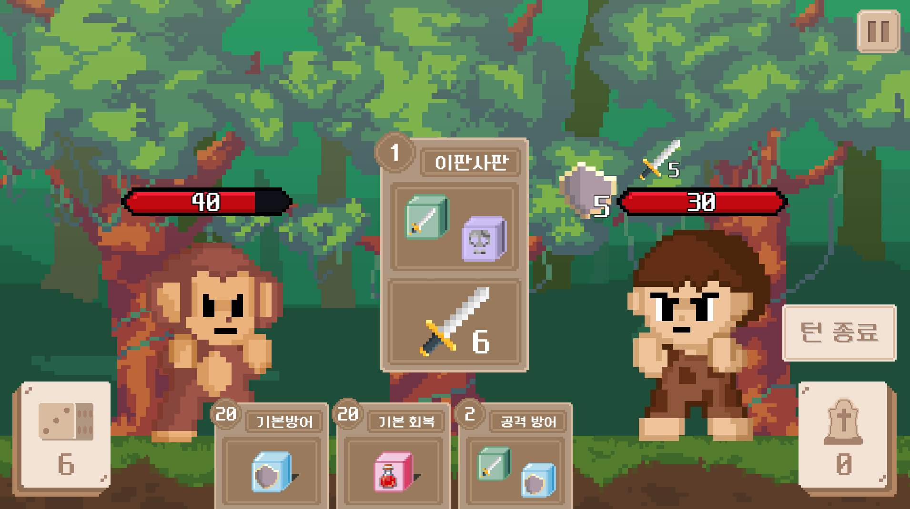
About Project
Play rule

Slide 10
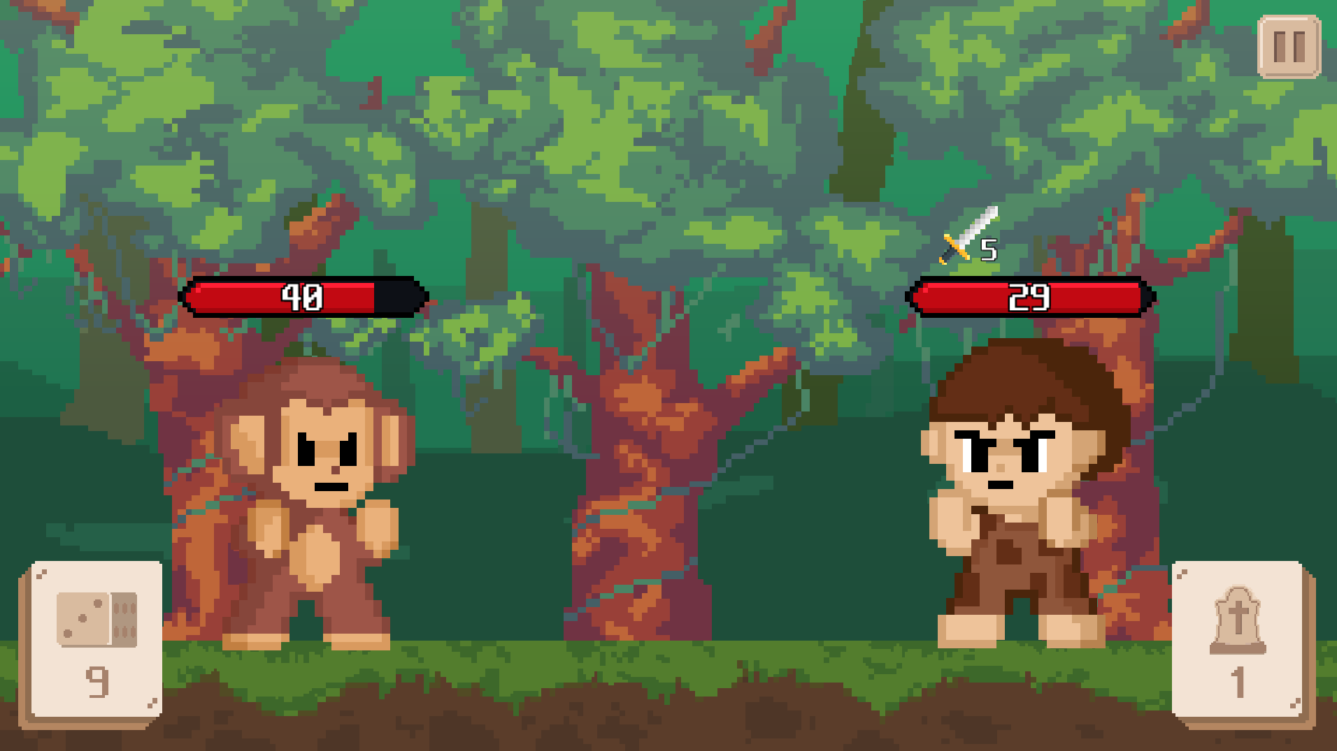
About Project
Play rule

Slide 11


Tool
Aseprite

Slide 12
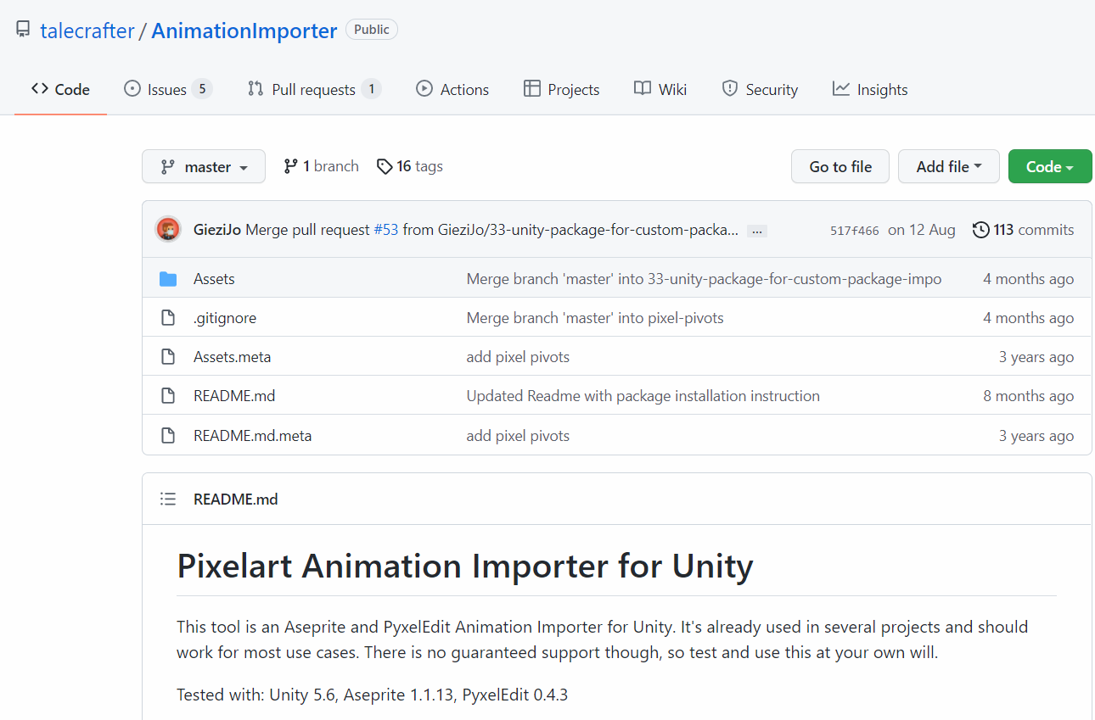
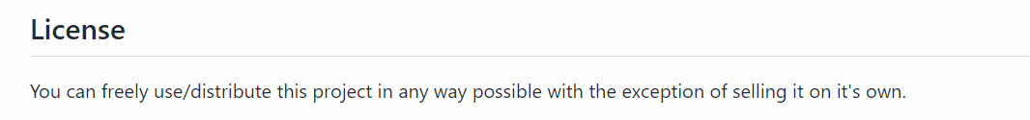
Opensource library
Aseprite Importer
In order to create fast animations for ‘Aseprite’

Slide 13
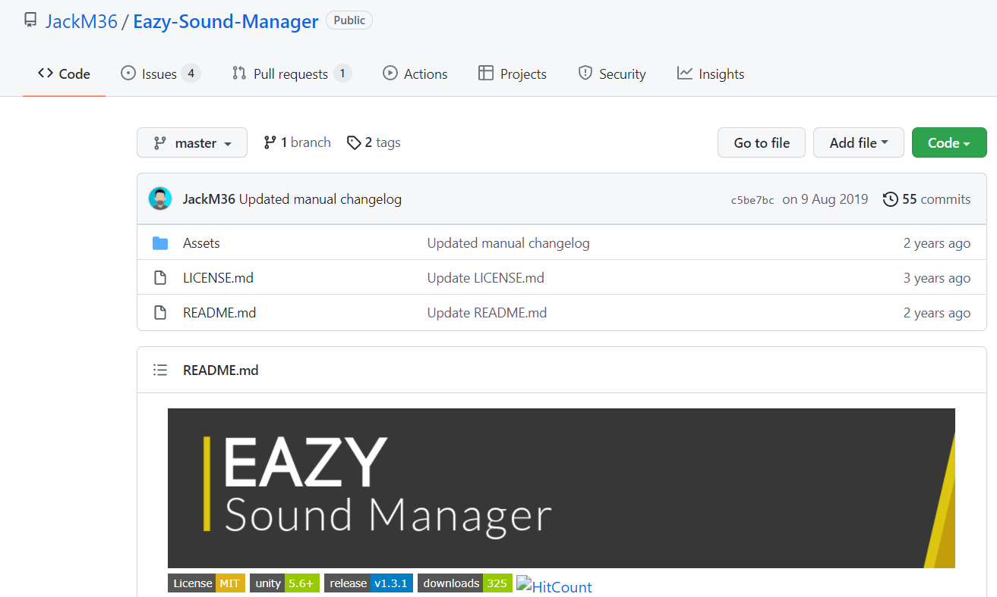
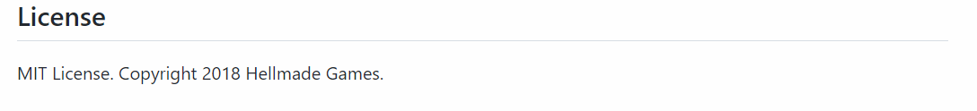
Opensource library
Easy Sound Manager
To play background music and other sounds easily

Slide 14

Opensource license

Slide 15
Team 5
강태훈
Game implementation. Character design
김유정
Each stage game screen and background design
UI design
Character design
이연비
Main screen design
UI design
Character design
이하형
Design and apply character motion that suits card skills

Slide 16
Team 5
 | Design | Game function | Decision
12/12 | Battle scene, main scene Pause, close button deck, grave button Card design | Card, data setting, deck list Hand function | Font
12/15 | Monster 2, 3 design Character motion Dice, component icons design | Grave button function Enemy, player function Database | SFX sounds
12/18 | Monster 4, 5 design Monster 2, 3 motion Ending scene | Battle function, victory & defeat decide function Get card, delete card function Enemy’s drop card list Stage select function | Background Music
12/20 | Monster 4, 5 motion | Direction (SFX, BGM, Animation) Bug fix, Balancing

Slide 17
